Slide 1


Inter-user Dependent Task Offloading and Resource
Allocation in Dynamic MEC Networks
Paper No: 49
Authors:
Tianyi Shi | Tiankui Zhang | Ruikang Zhong | Yuanwei Liu | Rong Huang
School of Information and Communication Engineering, Beijing University of Posts and Telecommunications, Beijing, China | School of Information and Communication Engineering, Beijing University of Posts and Telecommunications, Beijing, China | School of Electronic Engineering and Computer Science, Queen Mary University of London, London, U.K. | School of Electronic Engineering and Computer Science, Queen Mary University of London, London, U.K. | China Unicom Research Institute, Beijing, China
Source: 2024 IEEE International Conference on Communications (ICC)
Presented By: UMAR MUHAMMAD
Student ID: 20245364
Date: 2025-12-11
Department of Electrical Electronics and Computer Engineering, University of Ulsan, Ulsan, South Korea
1

Slide 2
Presentation Outline
  Introduction and Motivation
    → Challenges in dynamic MEC networks and real-world applications
  System Model and Problem Formulation
  → Network architecture, task processing model, and cost formulation
  Proposed PTORA Algorithm
    → Execution window partitioning, DDQN-based offloading, and JSATC resource allocation
  Numerical Results and Performance
    → Simulation setup, convergence analysis, and comparison with baseline methods
  Conclusion and Future Work
    → Key contributions, research directions, and deployment validation
2

Slide 3
The Challenge
Why Dynamic MEC Networks Are Complex
1. Terminal Mobility
Mobile devices constantly move, causing time-varying channel conditions that affect communication quality and reliability.
2. Real-time Requirements
Applications demand rapid decision-making without prior knowledge of network topology or dynamics.
3. Inter-user Dependencies
Complex tasks span multiple users with dependencies (autonomous driving, smart home) that must be preserved.
4. Delay-Energy Trade-off
Must jointly optimize task completion time and terminal energy consumption in resource-constrained environments.
💡 Traditional optimization methods struggle with dynamic environments, require repeated solving, and cannot handle long-term performance
3

Slide 4
Real World Applications
Why this research makes an impact
🚗
Intelligent Transportation
Dynamic high-precision map development requiring distributed computation across multiple connected vehicles.
👁️
Autonomous Driving
See-Through perception sharing between vehicles where tasks depend on each other for enhanced safety.
🏠
Smart Home/City
Distributed computing across IoT devices with serialized and parallel task dependencies.
Common Challenges Across Applications
Tasks distributed across multiple devices
Strict latency requirements
Limited battery life on terminals
Dynamic network conditions
4

Slide 5
Related Work
Task Offloading with Dependencies in MEC Networks
Reference | Approach | Limitations | This Paper
[6], [7], [8], [9] | DAG-based fine-grained offloading for single-user tasks | No inter-user dependencies Limited to single-user scenarios | Handles multi-user task dependencies Real collaborative scenarios
[10], [11] | Closed-form solutions with one-climb policy for linear dependencies | Only linear task structures Static users No mobility | Complex DAG structures Mobile terminals Dynamic channels
[12] | Heuristic algorithm for DAG critical path minimization | Requires prior knowledge Iterative solving Not adaptive | No prior knowledge needed Real-time decisions Continuous learning
GA / OCP | Evolutionary / Rule-based optimization | Repeated solving required Slow in dynamic environments No long-term optimization | Single forward pass Fast adaptation Long-term reward maximization
Research Gap
Previous works focused on independent tasks or single-user DAGs. Real-world scenarios involve inter-user task dependencies that require new optimization approaches.
5

Slide 6
Research Gap
What previous work is missing
Limitations in Prior Research
1. Independent Task Assumption
Most works ignore inter-user dependencies
2. Static Scenarios
Limited mobility considerations
3. Linear Dependencies Only
Not general DAG structures
4. Prior Knowledge Required
Can't adapt to unknown environments
What Paper Include
Inter-user task dependencies (DAG)
Terminal mobility and time-varying channels
Deep reinforcement learning approach
No prior knowledge required
Paper’s Contributions
Execution window partitioning
DDQN-based task offloading
Joint resource allocation (JSATC)
Long-term optimization
6

Slide 7
Paper’s Goal
Why this paper matters
Paper Solution: PTORA Algorithm
To develop a Deep Reinforcement Learning framework that jointly optimizes task offloading and resource allocation for inter-user dependent tasks in dynamic MEC networks by learning from the underlying graph representation of the network environment.
Key Innovation
Combine DDQN (Double Deep Q Network for intelligent offloading decisions) with JSATC (Joint Subchannel Allocation and Transmit Power Control for resource optimization) to achieve superior performance without requiring prior knowledge of network dynamics or task structures.
Main Objectives
1. Model Complex Dependencies
Handle inter-user task dependencies in multi-user scenarios using DAG structures.
2. Dynamic Adaptation
Account for terminal mobility and time-varying channel states in real-time.
3. Joint Optimization
Simultaneously optimize task offloading decisions and resource allocation.
7

Slide 8
Experimental Overview
What was tested and how
The paper uses SIMULATION-BASED EXPERIMENTS — No real-world dataset, but a comprehensive MEC network simulator with realistic parameters
Simulation Environment
Type: Custom Python-based MEC simulator
Framework: Python 3.8 with PyTorch 1.8.0
Hardware: Intel i5-10210U CPU
Purpose: Evaluate PTORA in dynamic MEC scenarios
What Was Measured
Primary metric: Weighted delay-energy cost
Convergence: Accumulated rewards over episodes
Scalability: Performance with varying edge server capacity
Adaptability: Different delay-energy trade-offs
Key Characteristics
Dynamic MEC Network
Mobile terminals with time-varying channels and mobility
Inter-user Dependencies
Tasks structured as DAGs spanning multiple users
Real-time Requirements
Fast decision-making without prior knowledge
8

Slide 9
What is PTORA?
Understanding proposed the algorithm at a high level
PTORA = Parallel Task Offloading & Resource Allocation
In a mobile edge computing (MEC) network where:
Tasks have dependencies across multiple users (DAG structure)
Network conditions change dynamically (mobility, time-varying channels)
Resources are limited (channels, power, computing capacity)
How do we decide which tasks to offload and how to allocate resources to minimize delay-energy cost?
Traditional Approach Problem
Requires complete prior knowledge
Must re-solve for every change
NP-hard optimization problem
Poor scalability
PTORA Solution
Learns from experience (no prior knowledge)
Adapts to dynamic changes automatically
Two-stage decomposition
Long-term optimization
9

Slide 10
Two-Stage Architecture
How PTORA breaks down the problem
Algorithm Overview
PTORA is a coupled two-stage optimization algorithm that combines Deep Reinforcement Learning for intelligent task offloading decisions with classical optimization for efficient resource allocation. The algorithm operates on execution windows partitioned from the DAG structure, enabling parallel processing while preserving inter-user task dependencies.
Stage 1: Learning
Stage 2: Optimization
Method: Double Deep Q Network (DDQN)
Method: Joint Subchannel Allocation & Transmit Power Control
Decision: Local execution (0) or Offload to ES (1)
Input: Offloading decisions from Stage 1
Goal: Maximize long-term cumulative reward
Solves: Power control (dichotomy) + Channel allocation (KM)
Learns: Optimal offloading policy from experience
Output: Actual cost for feedback to Stage 1
Coupling: Stage 1 provides decisions → Stage 2 allocates resources → Cost generates reward → Stage 1 learns and improves
10

Slide 11
PTORA - Stage 1
Task Offloading Decision (DDQN-based)
Double Deep Q Network (DDQN)
Uses two separate neural networks to make offloading decisions:
MainNet: Selects actions using ε-greedy policy
TargetNet: Evaluates Q-values for stability
Decoupling reduces overestimation bias in traditional DQN
Action Space (a_{i}^{m})
Binary decision for each subtask:
1
3
a_{i}^{m} ∈ {0, 1}
0: Execute locally on mobile terminal
1: Offload to edge server
Reward Signal (r_{i})
Designed to minimize the weighted delay-energy cost:
4
State Space (s_{i}^{m})
For each subtask v_{i}^{m} in execution window W_{i}:
① Subtask attributes: v_{i}^{m} = ⟨b^{s}, c^{s}, χ^{s}⟩
② Dependency info: q_{i}^{m} (Q groups for predecessors)
③ Parallel context: u_{i}^{m} (embedded info with Softmax attention)
2
r_{i} = -log₁₀(cost_{i})
All subtasks in the same execution window receive the same reward, encouraging coordinated decisions.
Network Update
Parameter Update and Target Calculation
5
s_{i}^{m} = v_{i}^{m} ∪ q_{i}^{m} ∪ u_{i}^{m}
11

Slide 12
PTORA - Stage 2
Resource Allocation (JSATC Algorithm)
Joint Subchannel Allocation and Transmit Power Control
Given offloading decisions from Stage 1, optimize communication resources for offloaded subtasks (W_{i}^{ES} ⊂ W_{i}).
Subchannel Allocation
Method: Kuhn-Munkres (KM) Algorithm
With optimal power p* from Step 1, formulate as a weighted bipartite graph matching problem:
Nodes: Offloaded subtasks ↔ Available subchannels
Weights: Communication cost for each (subtask, channel) pair
Constraint: One-to-one matching (orthogonal channels)
KM algorithm finds the optimal assignment β* that minimizes total cost.
1
3
minimize Σ (α^{D}d_{i}^{s,cm} + α^{E}e_{i}^{s,cm})
Transmit Power Control
Method: Dichotomy (Binary Search)
For each offloaded subtask and given subchannel allocation β, solve the quasi-convex optimization:
2
Feedback Loop
After resource allocation: (i) Calculate actual cost_{i} based on allocated resources (ii) Generate reward signal r_{i} for the DDQN agent (iii) Update agent's experience and network parameters
4
g(p) = b^{s}(α^{D} + α^{E}p) / [B₀ log₂(ph_{i,k}^{n}/σ²)]
Find optimal power p* that minimizes communication cost efficiently.
Coupling: Stage 1 provides offloading decisions → Stage 2 allocates resources → Stage 2's cost determines Stage 1's reward
12

Slide 13
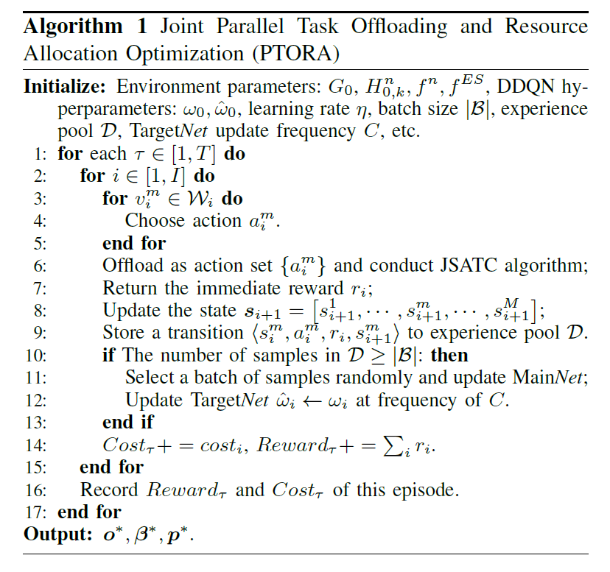
Proposed Algorithm: PTORA
Parallel Task Offloading and Resource Allocation
PTORA combines:
DDQN for intelligent task offloading decisions
JSATC for joint subchannel allocation & power control
Experience Replay for stable learning
Target Network for convergence
Key Features
Execution Window Partitioning: Enables parallel processing
ε-greedy Policy: Balances exploration vs exploitation
Coupled Optimization: Offloading decisions + resource allocation
Long-term Learning: Maximizes cumulative reward
No Prior Knowledge: Adapts to dynamic environments
13

Slide 14
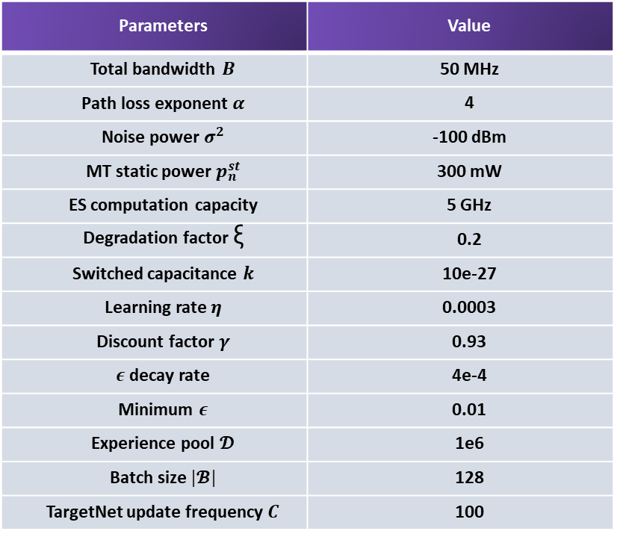
Simulation Setup and Parameters
Network Configuration
2 Mobile Terminals within 500m radius
8 Orthogonal Subchannels (50 MHz total)
Edge Server: 5 GHz computing capacity
Path loss exponent: α = 4
Table 4. Simulation Parameters
Parameters | Value
Total bandwidth $B$ | 50 MHz
Path loss exponent $α$ | 4
Noise power $σ^{2}$ | -100 dBm
MT static power $p_{n}^{st}$ | 300 mW
ES computation capacity | 5 GHz
Degradation factor ξ | 0.2
Switched capacitance $k$ | 10e-27
Learning rate $η$ | 0.0003
Discount factor $γ$ | 0.93
$ε$decay rate | 4e-4
Minimum $ε$ | 0.01
Experience pool $𝓓$ | 1e6
Batch size $|𝓑|$ | 128
TargetNet update frequency $C$ | 100
Task Characteristics
Per Service Request:
10 Subtasks with inter-user dependencies
Input data: 250-500 KB (uniform)
Result data: 40-80 KB (uniform)
Computation: 500-900 Mcycles (uniform)
DDQN Configuration
Learning rate: 0.0003 (Adam optimizer)
Discount factor: γ = 0.93
Experience pool: 1 million transitions
Batch size: 128 samples
ε decay: 4×10⁻⁴ (min: 0.01)
Target update: Every 100 steps
14

Slide 15
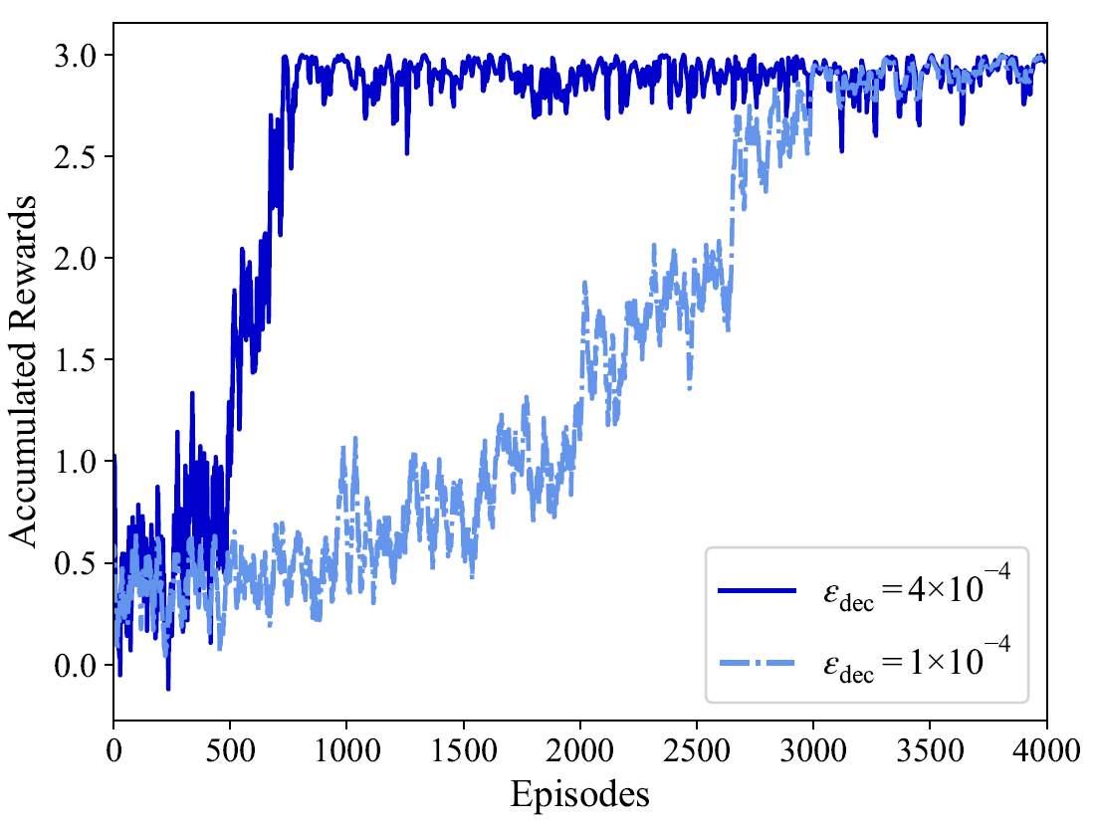
Results: Convergence Analysis
DDQN Learning Progress:
Both ε decay rates show steady convergence
Accumulated rewards increase consistently over episodes
System learns optimal long-term offloading strategy
Stable performance achieved after convergence
Exploration vs Exploitation Trade-off:
Larger ε decay (4×10⁻⁴):
Rapid transition to exploitation phase
Quick convergence - ideal for time-constrained scenarios
Faster policy stabilization
Smaller ε decay (1×10⁻⁴):
More cautious exploration strategy
Extended random action period in late training
Potentially discovers better long-term policies
Requires more episodes to converge
Fig 5. Convergence of the accumulative reward.
Findings
The PTORA algorithm successfully learns to optimize task offloading decisions through deep reinforcement learning, achieving stable convergence and demonstrating the effectiveness of DDQN in handling dynamic MEC environments with inter-user dependencies. The convergence behavior validates that the agent effectively maximizes long-term rewards, which directly correlates to minimizing the weighted delay-energy cost. Both ε decay configurations prove viable, with the choice depending on deployment urgency versus exploration thoroughness requirements.
15

Slide 16
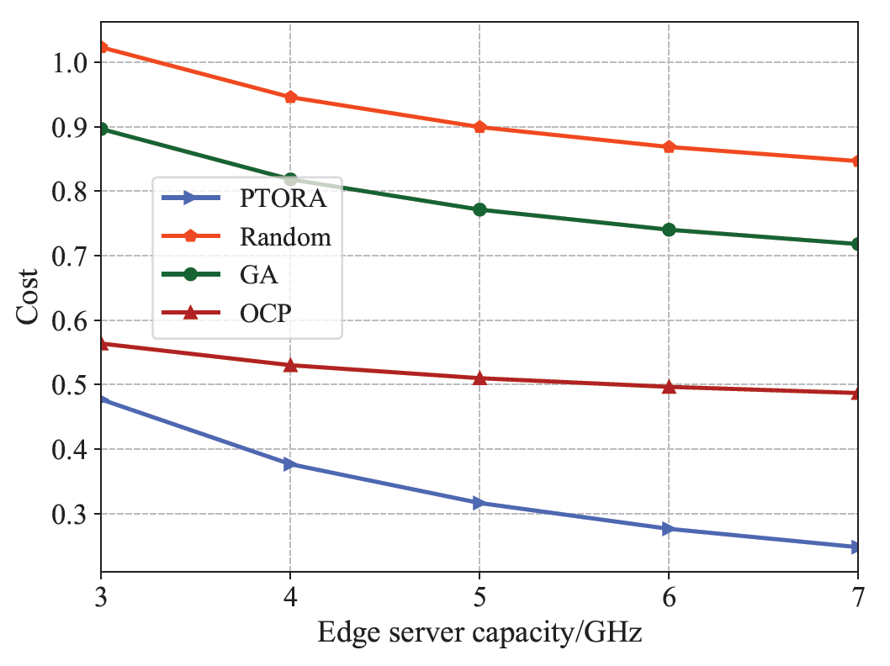
Results: Edge Server Capacity Impact
Table 5. Performance Comparison
Method | Cost | Vs PTORA
PTORA | ~0.27 | Best
OCP | ~0.50 | -
GA | ~0.70 | -
Random | ~0.75 | -
Observations
Faster task processing → Lower delay
Reduced idle power consumption
All algorithms benefit from increased capacity
Why PTORA performs better
Dynamic learning and adaptation
Long-term optimization via Deep RL
Handles inter-user dependencies effectively
Fig 7. Cost with varying ES computation capacity.
Takeaway
PTORA achieves 63% cost reduction through Deep RL optimization. It consistently outperforms traditional methods by learning and adapting to dynamic environments.
16

Slide 17
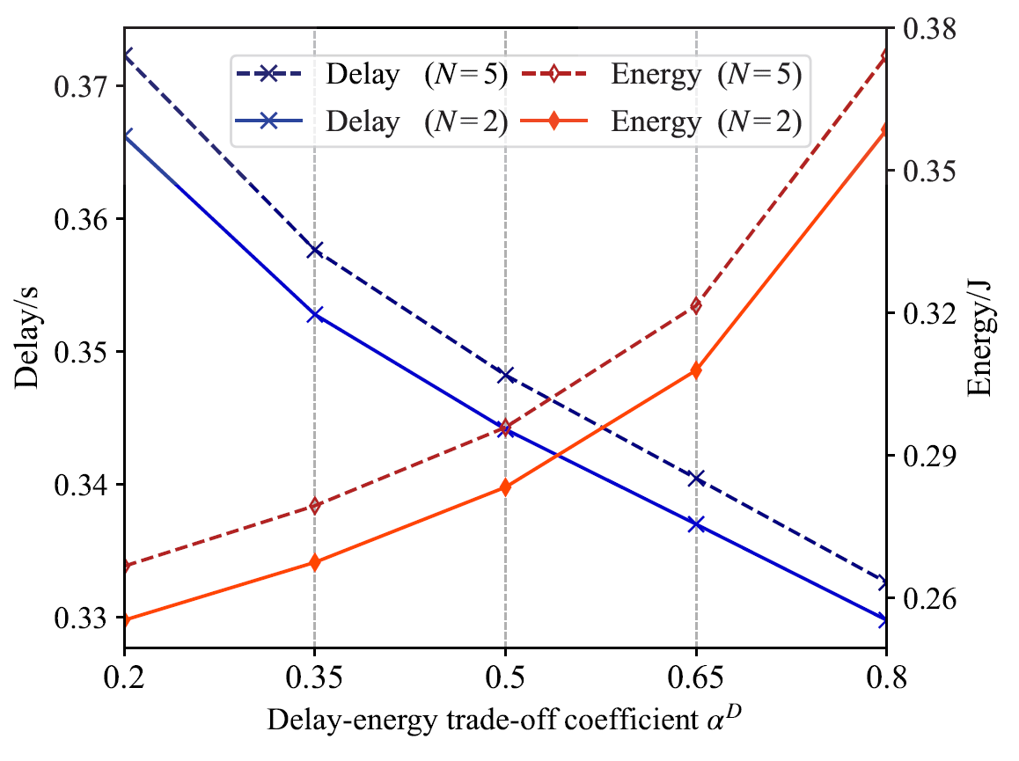
Results: Delay-Energy Trade-off Analysis
Trade-off Behavior
As α^{D} increases, prioritizing delay (0.2 → 0.8):
✓ Task completion delay decreases (~11% reduction)
✗ Energy consumption increases (~32% increase)
→ System prioritizes speed over efficiency
Key Insight: Adjustable weights allow flexibility for different application needs
Impact of Terminal Count
N = 5 terminals
Delay: 0.34s - 0.38s (+3%)
Energy: 0.28J - 0.38J (+8%)
N = 2 terminals
Delay: 0.33s - 0.37s
Energy: 0.26J - 0.35J
Fig 7. Delay-energy trade-off coefficient $α^{D}.$
→ More users = Higher system complexity and resource contention
Takeaway
PTORA adapts to different scenarios by adjusting weight coefficients.
17

Slide 18
Contributions
1. Comprehensive System Model: First work to jointly consider inter-user task dependencies, terminal mobility, and time-varying channels using DAG structure
2. Novel Cost Formulation: Delay-energy weighted cost model with base costs and dependency costs, accounting for VM interference and parallel execution
3. PTORA Algorithm: Deep RL solution with execution window partitioning, DDQN-based offloading, and JSATC resource allocation for long-term optimization
4. Superior Performance: Comprehensive simulations demonstrate PTORA outperforms GA, OCP, and Random baselines with validated adaptability across scenarios
Impact: This work enables fully autonomous, zero-touch MEC network management for next-generation applications
18

Slide 19
Takeaways
1. Complex Problem, Elegant Solution
Inter-user dependencies + mobility + dynamics → PTORA with execution window partitioning
2. Deep Reinforcement Learning Works
DDQN-based approach achieves long-term optimization without prior knowledge
3. Superior to Traditional Methods
Outperforms GA, OCP, and Random across all tested configurations
4. Flexible and Adaptable
Adjustable delay-energy weights adapt to diverse application requirements
5. Foundation for Future Networks
Enables autonomous MEC for intelligent transportation, IoT, and beyond
19

Slide 20
Paper’s Limitations
Limited Benchmark Comparisons
Performance is compared only against GA, OCP, and Random strategies. Comparison with other state-of-the-art deep learning approaches (e.g., PPO, A3C, multi-agent RL) and recent dependency-aware offloading methods would provide more comprehensive validation.
1
Ideal Channel Assumptions
The model assumes perfect channel state information (CSI) and uses simplified path loss models. In practice, channel estimation errors, fading, interference, and measurement delays could degrade offloading performance and require robust adaptive mechanisms.
2
DDQN Training Convergence
The algorithm requires 1,500-2,500 episodes to converge, which is computationally expensive. The exploration-exploitation tradeoff (ε-decay rate selection) significantly impacts convergence speed, and no theoretical convergence guarantees are provided for the dynamic multi-agent scenario.
3
Static Task Generation Pattern
Tasks are generated with fixed parameters (data size: 250-500 KB, computation: 500-900 Mcycles). Real applications exhibit highly dynamic and bursty traffic patterns with heterogeneous QoS requirements that may challenge the current execution window partitioning strategy.
4
20

Slide 21
Future Research Directions
1. Multi-tier Architectures
Extend to hierarchical edge computing with cloudlets, fog nodes, and central cloud for ultra-low latency
2. Heterogeneous Resources
Consider GPUs, NPUs, FPGAs and optimize task-to-resource mapping based on workload characteristics
3. Security and Privacy
Incorporate data sensitivity, encryption overhead, and privacy-preserving computation constraints
4. Federated Learning
Combine federated learning with task
offloading for collaborative model training at the edge
Deployment Validation
ITS testbeds
Autonomous vehicle platforms
Autonomous vehicle platforms
Future Goal: Fully autonomous networks that self-configure, self-optimize, and self-heal
21

Slide 22
References (1/2)
[1] T. Shi, T. Zhang, R. Zhong, Y. Liu, and R. Huang, “Inter-user dependent task offloading and resource allocation in dynamic MEC networks,” in Proc. IEEE International Conference on Communications (ICC), Denver, CO, USA, 2024, pp. 3925–3930, doi: 10.1109/ICC51166.2024.10622907.
[2] L. A. Haibeh, M. C. E. Yagoub, and A. Jarray, “A survey on mobile edge computing infrastructure: Design, resource management, and optimization approaches,” IEEE Access, vol. 10, pp. 27 591–27 610, 2022.
[3] P. Arthurs, L. Gillam, P. Krause, N. Wang, K. Halder, and A. Mouzakitis, “A taxonomy and survey of edge cloud computing for intelligent transportation systems and connected vehicles,” IEEE Transactions on Intelligent Transportation Systems, vol. 23, no. 7, pp. 6206–6221, Jul. 2022.
[4] T. Fang, F. Yuan, L. Ao, and J. Chen, “Joint task offloading, D2D pairing, and resource allocation in device-enhanced MEC: A potential game approach,” IEEE Internet of Things Journal, vol. 9, no. 5, pp. 3226–3237, Mar. 2022.
[5] H. Jiang, X. Dai, Z. Xiao, and A. Iyengar, “Joint task offloading and resource allocation for energy-constrained mobile edge computing,” IEEE Transactions on Mobile Computing, vol. 22, no. 7, pp. 4000–4015, Jul. 2023.
[6] N. Zhao, W. Du, F. Ren, Y. Pei, Y.-C. Liang, and D. Niyato, “Joint task offloading, resource sharing and computation incentive for edge computing networks,” IEEE Communications Letters, vol. 27, no. 1, pp. 258–262, 2023.
[7] H. Liao, X. Li, D. Guo, W. Kang, and J. Li, “Dependency-aware application assigning and scheduling in edge computing,” IEEE Internet of Things Journal, vol. 9, no. 6, pp. 4451–4463, Mar. 2022.
[8] J. Liu, J. Ren, Y. Zhang, X. Peng, Y. Zhang, and Y. Yang, “Efficient dependent task offloading for multiple applications in MEC-cloud system,” IEEE Transactions on Mobile Computing, vol. 22, no. 4, pp. 2147–2162, Apr. 2023.
[9] J. Chen, Y. Yang, C. Wang, H. Zhang, C. Qiu, and X. Wang, “Multitask offloading strategy optimization based on directed acyclic graphs for edge computing,” IEEE Internet of Things Journal, vol. 9, no. 12, pp. 9367–9378, Jun. 2022.
22

Slide 23
References (2/2)
[10] X. Lv, H. Du, and Q. Ye, “Tbtoa: A DAG-based task offloading scheme for mobile edge computing,” in Proc. IEEE International Conference on Communications (ICC), May 2022, pp. 4607–4612.
[11] J. Yan, S. Bi, and Y.-J. A. Zhang, “Optimal offloading and resource allocation in mobile-edge computing with inter-user task dependency,” in Proc. IEEE Global Communications Conference (GLOBECOM), Dec. 2018, pp. 1–8.
[12] J. Yan, S. Bi, Y.-J. A. Zhang, and M. Tao, “Optimal task offloading and resource allocation in mobile-edge computing with inter-user task dependency,” IEEE Transactions on Wireless Communications, vol. 19, no. 1, pp. 235–250, Jan. 2020.
[13] J. Yang et al., “A parallel intelligence-driven resource scheduling scheme for digital twins-based intelligent vehicular systems,” IEEE Transactions on Intelligent Vehicles, vol. 8, no. 4, pp. 2770–2785, Apr. 2023.
[14] S.-W. Ko, K. Han, and K. Huang, “Wireless networks for mobile edge computing: Spatial modeling and latency analysis,” IEEE Transactions on Wireless Communications, vol. 17, no. 8, pp. 5225–5240, Aug. 2018.
[15] C. Kai, S. Xiao, Y. Yi, M. Peng, and W. Huang, “Dependency-aware parallel offloading and computation in MEC-enabled networks,” IEEE Communications Letters, vol. 26, no. 4, pp. 853–857, Apr. 2022.
[16] R. Liu, M. Sheng, and W. Wu, “Energy-efficient resource allocation for heterogeneous wireless network with multi-homed user equipments,” IEEE Access, vol. 6, pp. 14 591–14 601, 2018.
23

Slide 24
Thank You
24

